Slide 1

Creating Accessible,
Inclusive, Warm
Welcome Spaces.
Volunteer briefing

Slide 2
Today we’ll cover…
Thinking about access and inclusion in an equitable way
Barriers that exist across society and ways to remove them
Ways to talk about access and ask people what works for them
How you can use the Warm Welcome Spaces Inclusion Toolkit

Slide 3
Three ingredients that make more people feel welcome
Equity
Accessibility
Inclusion
Recognising that people don’t all start from the same place. For some people to experience a space equally, they may need different support.
Recognising that barriers exist for people from marginalised groups, and finding ways to reduce or remove them. Access isn’t only about disabled people.
Creating a space where people from all backgrounds feel they belong and are valued. People aren’t just allowed to be there, they’re actively welcomed.

Slide 4
Note: barriers, not people,
are the problem.

Slide 5
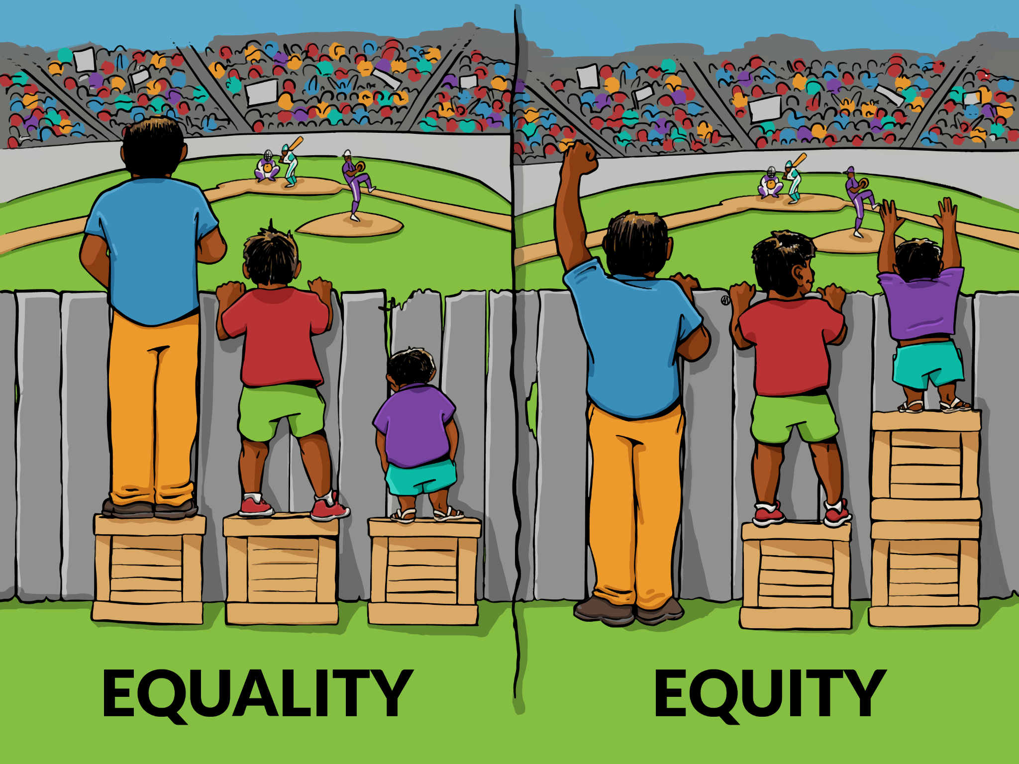
The difference between equity and equality

Slide 6
Why be inclusive?
Warm Welcome Spaces offer refuge, connection and comfort. That purpose is undermined if any member of our community feels unwelcome or unable to access them.
People who most need these spaces often face intersecting barriers: disability, language differences, neurodivergence, poverty, cultural exclusion, or mental health challenges.
Inclusion isn’t an add-on. It’s the foundation that makes a Warm Welcome Space truly warm.

Slide 7
Why work on this?
We know some groups are less likely to access warm spaces. Those most isolated from services include:
People living rurally or isolated from transport
Solo families
People with disabilities
Global majority communities
People who identify as LGBTQI+
People with mental health challenges
Refugees, asylum seekers, non-English speakers
Travellers and Roma communities
Older men
These are the communities most impacted by fuel poverty and social isolation. They are in great need of Warm Welcome Spaces.

Slide 8
Cognitive bias
We all carry cognitive biases - mental shortcuts that shape how we respond to people, often without us realising.
In warm welcome spaces, this might look like:
Making assumptions about someone based on how they look
Feeling more comfortable helping people who seem “like us”
Biases shaped by media and personal experience
Our job isn’t to be bias-free – it’s to be bias-aware.

Slide 9
Anti-discriminatory practice
Actively challenging unfair treatment and the systems that allow it – not just avoiding discrimination ourselves.
Being willing to step in when someone is treated differently because of their race, disability, gender, age, sexuality, or any other characteristic
Looking at how our spaces operate and asking whether our processes, language, or environment might unintentionally exclude people
Taking responsibility for creating an environment where everyone is treated with dignity and respect

Slide 10
Anti-discriminatory practice
Good intentions aren’t enough on their own.

Slide 11
Anti-oppressive practice
Recognising that some people face deeper, structural disadvantages - not just individual discrimination, but patterns built into how society works.
People walking through our doors may carry the weight of poverty, racism, ableism, or other forms of marginalisation
Be mindful of power dynamics and avoid making people jump through hoops to access support
Make sure our spaces don’t mirror the very systems that have let people down

Slide 12
Anti-oppressive practice
It’s about standing alongside people, not above them.

Slide 13
Barriers to inclusion
and their remedies
Understanding what gets in the way – and what you can do about it

Slide 14
Information and communication barriers
Ask: “Is there anything you need to make the space work for you?” is a great way to open the conversation.

Slide 15
Information and communication barriers
Many people feel anxious about coming somewhere new. A warm smile, showing them around, and explaining where to find refreshments and toilets can make all the difference
Simple gestures like learning someone’s name and making an effort to chat help people feel genuinely welcome
If your space lacks diverse imagery - racially, culturally, in terms of disability or LGBTQI+ representation - people may feel it “isn’t for them”

Slide 16
Information and communication barriers
You’ll find inclusive posters and social media resources in the Digital Resource Bank, of the Inclusion Toolkit in your Warm Welcome Spaces Dashboard

Slide 17
Creating accessible communications
Simple changes to how you present information make a big difference:
Use a large, sans serif font (such as Arial) – minimum size 14 in print, 24 on slides
Ensure strong colour contrast between text and background
Use images to support written messages wherever possible
Consider PEC boards for non-verbal communication – affordable and available online

Slide 18
Getting through the door – representation and welcome
If people can’t see someone who looks like them in your space, they may not feel welcome
Have volunteers who can speak languages from the communities you serve
Clear signs show people they are welcome – flags from around the world, a rainbow flag, or multilingual welcome posters
Give clear information about arrival times, what to expect, and how the space works

Slide 19
Getting through the door – practical flexibility
Being flexible when people ask for extra help makes a huge difference: providing a space to pray, moving seats for a wheelchair user, offering straws – every small action helps
Always offer help – never force it. People like to be given choices. Respect their decisions, even if something takes them longer
Follow through on the help someone asks for. Being let down after asking is more discouraging than not being asked at all

Slide 20
Making space for families
Families aren’t always sure if a community activity welcomes children- here are some starter tips:
Provide baby change facilities and bottle warming where possible
Have some age-appropriate toys and activities for families to share
Avoid jumping in when children are crying – let parents handle it in the way that works for their family
Help single parents feel welcome by introducing them to other parents

Slide 21
Be a good racial diversity ally
Listen and learn – listen to experiences of people from racially diverse backgrounds without centering your own perspective
Educate yourself – it’s not the responsibility of global majority communities to teach you about racism. Seek out resources
Acknowledge privilege and power – actively recognise your own position and work with integrity to tackle racism in your setting
Recognise intersectionality – people may face multiple discriminations at once (disability, LGBTQI+ status, gender, religion). This compounds their experience
Use your voice – speak up when you witness racist language or exclusion, even when the person affected isn’t in the room

Slide 22
Physical barriers
What you can change – and what you can communicate

Slide 23
Improving physical spaces
Create more space between chairs and tables for wheels and walking aids
Place tables and chairs near the refreshment area
Make trays and straws available
Keep the accessible toilet clear and make sure everyone knows where the key is
De-clutter corridors for easy access with walking aids or pushchairs
Consider access buttons on heavy doors (fire doors excluded)
Try to arrange ramps where there are steps

Slide 24
Improving physical spaces
Let people know if your space is wheelchair friendly on social media and posters. Resources are in the Digital Resource Bank.

Slide 25
Physical spaces – supporting independence
The physical layout can support people to feel dignified and independent:
Create space so people can move freely to refreshments, toilets and exits
Lay out the refreshment area so someone can pop a cup down while they choose their own biscuit
Ask a wheelchair user if they’d rather stay in their chair or transfer to another

Slide 26
Sensory barriers
All sorts of people experience sensory barriers – neurodivergent people, stroke survivors, those with cognitive disabilities.
Offer a mix of cushioned and hard chairs - certain textures can be uncomfortable
Lighting, sound and temperature can be uncomfortable or overstimulating – adjust where possible
If you can allocate a quiet room or area, signpost it when people arrive
Movable furniture helps guests and interpreters position themselves as needed

Slide 27
Sensory barriers
A Neurodiversity Guide is available in the Digital Resource Bank.

Slide 28
Inclusion in action – case studies
Wroughton Library, Swindon
Worked with the Roxi Foundation (a local neurodivergent charity) to plan changes. Introduced coloured tissue window displays, a safe space teepee, sensory items, and imaginative play resources. Now have several neurodivergent volunteers.

Slide 29
Inclusion in action – case studies
Thursdays Together, Southampton
Noticed people waiting outside rather than coming in – the community room felt overwhelming when busy. Expanded seating to create a quieter corner with sofas away from the busiest areas. Now visitors can choose what suits them.

Slide 30
Inclusion in action – case studies
Wroughton Library, Swindon
Small, thoughtful changes can transform how a space feels – for guests and volunteers alike.

Slide 31
Thinking of your space
Have these examples made you think about small changes your space could try?
Why not note them down now?
Even one or two ideas is a great start.

Slide 32
Talking about access
How and when to have the conversation

Slide 33
Talking about access – what to say
To avoid assumptions, ask everyone as you greet them, especially new guests:
“If there’s anything you need, just ask a team member.”
“Would you like me to help you with anything?”
“Do you have any questions about the space?”
“It’s your first visit – is there anything you’re unsure about?”
“Just so you know, we have an accessible toilet / quiet space / toys and crafts / alternative milk.”

Slide 34
Talking about access – what to say
To avoid assumptions, ask everyone as you greet them, especially new guests

Slide 35
Talking about access – what to say
“Would you like me to show you where to get refreshments?

Slide 36
Talking about access – what to say
“Can I make you a cup of tea – we have different types of milk”

Slide 37
Talking about access – what to say
“Can I help you find a place to sit?”

Slide 38
Talking about access – what to say
If you tell everyone what’s available, you’re not assuming who needs it.

Slide 39
Thank you!
Volunteers are at the heart of what makes a Warm Welcome Space so wonderfully welcoming.
If you have questions about access in your space, ask your Warm Welcome Space Lead.
You’ll find additional resources in the Inclusion Toolkit on the Warm Welcome Dashboard.

